Slide 1
AMBIKA K
COLLEGE NAME: SARANATHAN COLLEGE OF ENGINEERING
BRANCH:ARTIFICIAL INTELLIGENCE AND DATA SCIENCE
YEAR: THIRD YEAR
NM ID: au813821243007
REGISTER NUMBER:813821243007
EMAIL ID: ambikalakshmi871@gmail.com
Final Project: HANDWRITTEN DIGIT RECOGNITION USING NEURAL NETWORK
3/21/2024 Annual Review

Slide 2
HANDWRITTEN DIGIT RECOGNITION USING NEURAL NETWORK
3/21/2024 Annual Review

Slide 3


AGENDA
PROBLEM STATEMENT
PROJECT OVERVIEW
WHO ARE THE END USERS?
YOUR SOLUTION AND ITS VALUE PROPOSITION
SYSTEM APPROACH
ALGORITHM AND DEPLOYMENT
THE WOW IN YOUR SOLUTION
MODELLING
RESULTS
CONCLUSION
REFERENCES
3/21/2024 Annual Review

Slide 4

PROBLEM STATEMENT
Develop a neural network-based system for handwritten digit recognition tailored specifically for disabled individuals, ensuring accessibility and usability for users with visual, motor, or cognitive impairments.
The goal is to empower disabled individuals by providing them with a reliable and intuitive tool for accessing and interacting with numerical information in everyday tasks.
3/21/2024 Annual Review

Slide 5
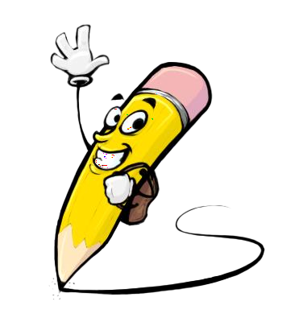
PROJECT OVERVIEW
Research
Data Collection
Model Development
Training and Optimization
Integration
Evaluation
Documentation
Expected Outcomes:
A neural network-based system capable of accurately recognizing handwritten digits, tailored to meet the accessibility needs of disabled individuals.
3/21/2024 Annual Review

Slide 6

WHO ARE THE END USERS?
Visually impaired individuals:
Users who are blind or have low vision.
Rely on assistive technologies like screen readers or braille displays.
Motor-impaired individuals:
People with physical disabilities affecting motor skills.
Require alternative input methods such as gestures or voice commands..
Individuals with cognitive disabilities:
Those with conditions like dyslexia or developmental disorders.
Need simplified interfaces and clear visual cues.
3/21/2024 Annual Review

Slide 7

YOUR SOLUTION AND ITS VALUE PROPOSITION
SOLUTIONS
Our solution, the "Neural Network-Based Handwritten Digit Recognition for Disabled Individuals," is a pioneering system designed to provide accessible and user-friendly handwritten digit recognition tailored specifically for users with visual, motor, or cognitive impairments. The solution integrates cutting-edge neural network technologies with inclusive design principles to ensure accessibility and usability for a diverse range of disabled users.
VALUE PROPOSITION:
Accessibility
Usability
Independence
Inclusivity
Continuous Improvement
3/21/2024 Annual Review

Slide 8
SYSTEM APPROACH
SYSTEM REQUIREMENTS:
1.Hardware:
CPU:
- Minimum CPU with dual-core, 2.0 GHz clock speed or higher for training and inference tasks.
2.RAM:
- Minimum 8GB RAM for handling training data batches and model operations efficiently.
3. Internet Connection:
- Stable internet connection for downloading datasets, accessing resources, and potential cloud-based training or inference.

Slide 9
SOFTWARE REQUIREMENTS
Python programming language for developing and implementing the deep learning model and related scripts of the project.
TensorFlow, Keras, for building and training the sequential model for handwritten digits recognition.
Data Processing Libraries - NumPy and Pandas for efficient data manipulation and preprocessing tasks.
Visualization Libraries - Matplotlib or Seaborn for visualizing the training process, model performance, and handwritten digit images.
Google colab for interactive development, experimentation, and documentation.

Slide 10
ALGORITHM AND DEPLOYMENT
DATA PREPARATION:
To download the MNIST dataset from TensorFlow-Keras, visit the official TensorFlow website or keras downloading the MNIST dataset.
SEQUENTIAL MODEL:
The sequential model allows for a straightforward layer-by-layer configuration of the neural network, making it easy to understand and implementation. Layers are added sequentially, and each layer is fully connected to the next, enabling a clear flow of data from input to output without complex connection.
This architecture is well-suited for tasks like handwritten digit recognition, where data flows through the network in one direction, allowing for quick forward propagation of information.
DEPLOYMENT:
The trained sequential model was deployed in the Github repository.

Slide 11

THE WOW IN YOUR SOLUTION
1. Accessibility-first Approach: Prioritizing Accessibility for Disabled Users
2. User-friendly Interfaces: Making Interaction Intuitive and Easy
3. Adaptive Neural Network Models: Dynamic Learning for Improved Recognition
4. Integration with Assistive Technologies: Seamlessly Enhancing Accessibility
5. Continuous Improvement through User Feedback: Iterative Refinement for Better User Experience
6. Empowerment of Disabled Individuals: Enabling Independence and Inclusion
3/21/2024 Annual Review

Slide 12
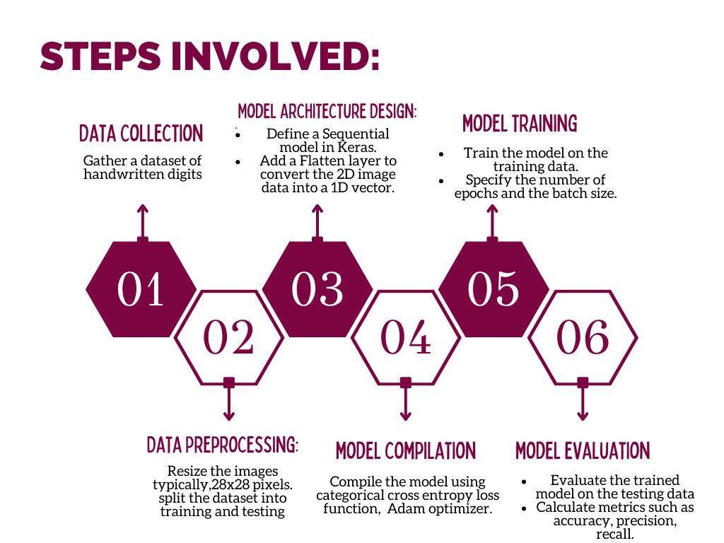
MODELLING
3/21/2024 Annual Review

Slide 13
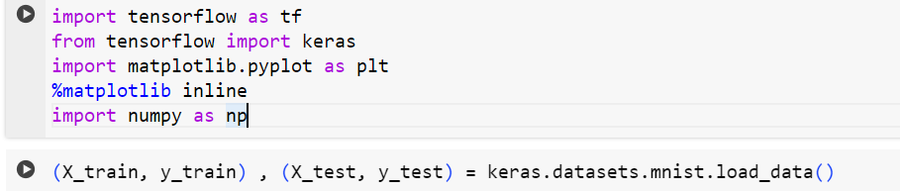
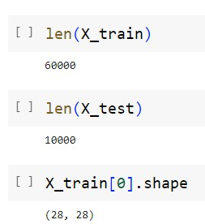
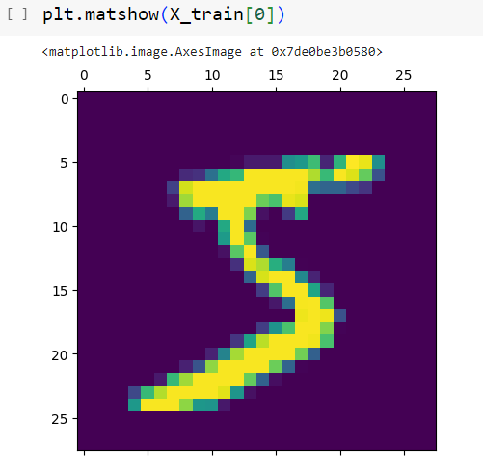
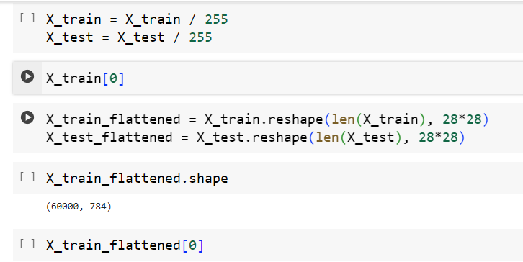
Importing dependencies and dataset
Preprocessing

Slide 14
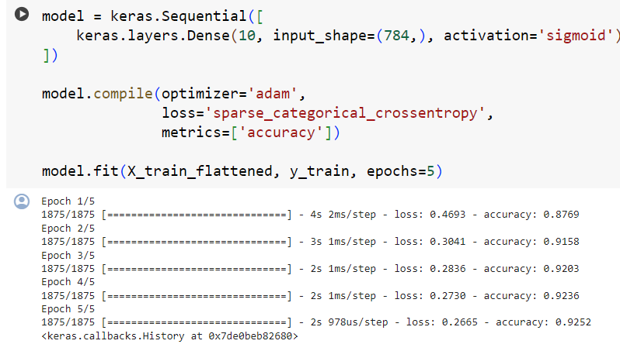
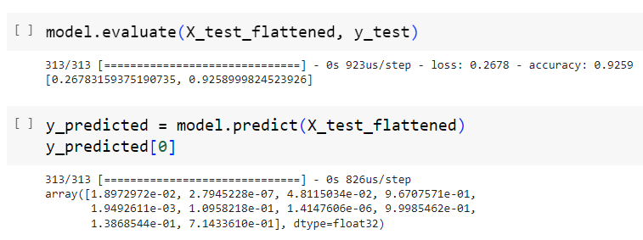
Model Training
Model Evaluate
Model Prediction

Slide 15
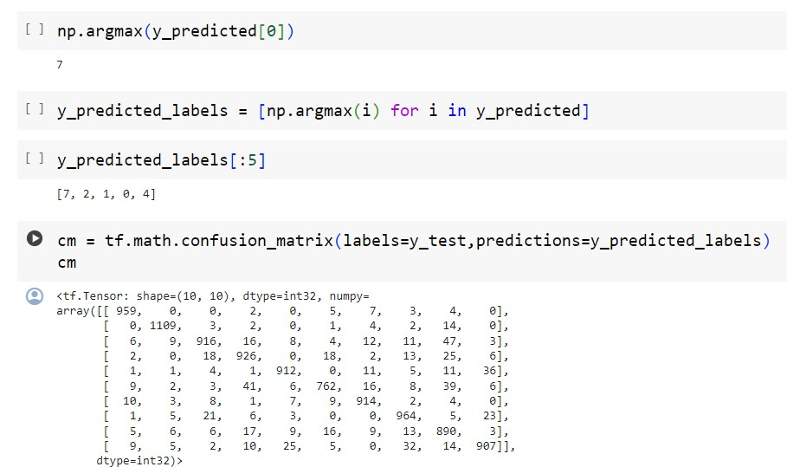
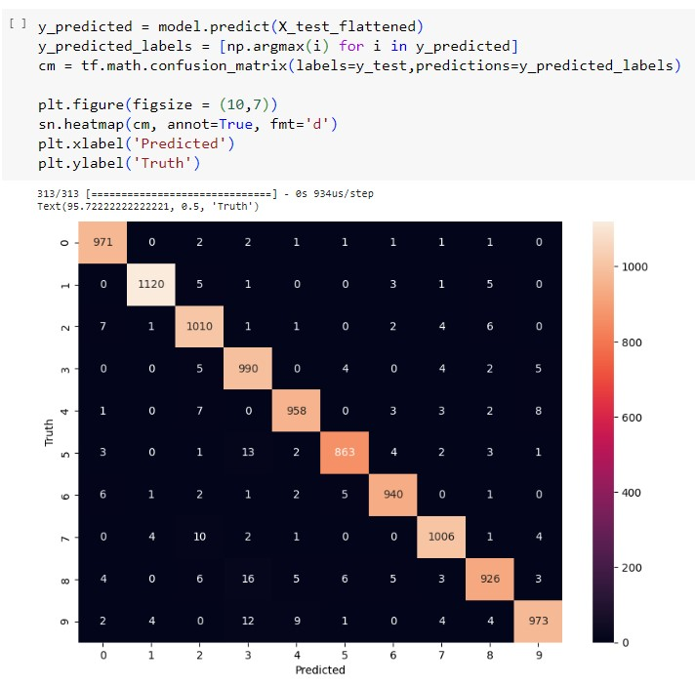
Model Confusion Matrix
Visualisation

Slide 16
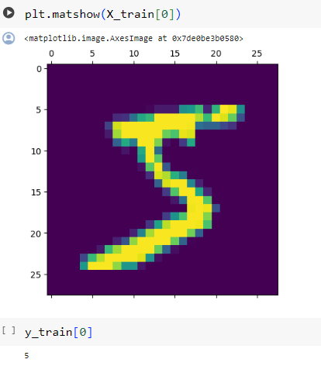
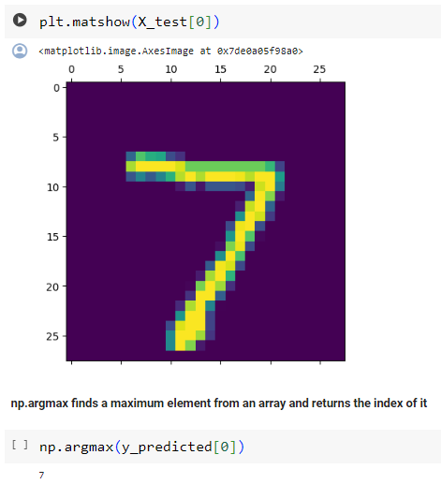
RESULTS
https://colab.research.google.com/drive/1n8s9liiXLCGSn88NRExlFKj3cIiQwMHU#scrollTo=sjx6WDvfAAM5
3/21/2024 Annual Review

Slide 17
CONCLUSION
In conclusion, leveraging a sequential model of a feedforward neural network offers a straightforward yet effective approach for handwritten digit recognition, providing efficient training and inference processes. With careful consideration of system requirements and algorithmic design, this project aims to deliver accurate and scalable digit recognition capabilities.

Slide 18
REFERENECES:
https://www.tensorflow.org/
https://keras.io/
https://numpy.org/
https://matplotlib.org/
https://scikit-learn.org/
https://storage.googleapis.com/tensorflow/tf-keras-datasets/mnist.npz

